Slide 1


SMART INDIA HACKATHON 2026
TITLE PAGE
Problem Statement ID – SIH26204
Problem Statement Title- AI-Powered Personal Assistant for Proactive Daily Task Automation and Inclusive Accessibility
Theme- Assistive Technologies and Inclusive Innovation
PS Category: Software
Team ID- SIH2026-314
Team Name: Code Kendra
Team Leader Name : Shrestha Srivastava
Team Leader USN Number: ENG25CS0760
School of Engineering, Dayananda Sagar University, Bengaluru - 562112.

Slide 2
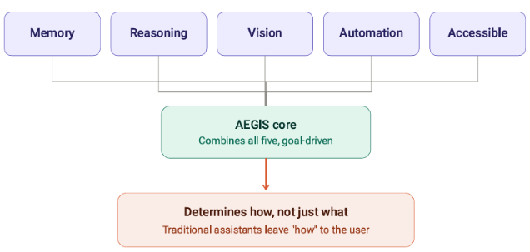
AEGIS —
Assisted Executive Guidance and Intelligence System
Code
Kendra
Proposed Solution:
Detailed Explanation
Personalized AI agent understands user goals, preferences and context, converting natural-language or voice requests into actionable, multi-step tasks
Interacts with authorized apps, files, APIs, and devices — providing feedback to the user throughout execution
How It Addresses the Problem
Reduces cognitive load, repetitive work, and manual interaction by proactively handling predictable tasks
Accessibility-first design (voice, TTS, visual/haptic feedback, alternative inputs) enables greater digital independence for users with different abilities
Innovation & Uniqueness
Focuses on the user's goal
Combines personal memory + contextual reasoning + vision +
authorized automation + accessibility to determine how a task gets done
"Tell AEGIS what you want. AEGIS determines how to get it done."

Slide 3
TECHNICAL APPROACH
Code Kendra
INPUT
Microphone / Camera / Chat
UNDERSTAND
Faster-Whisper + YOLOv5m ONNX
ROUTE
Deterministic Router <5 ms
REASON
Gemini 2.5 Flash (API)+ Free Search
ACT
Win32 / Browser / Media / Reminders
MEMORY
SQLite + Spatial Episodic Memory
Key implementation
• FastAPI + Uvicorn • React 18 + TypeScript + Vite • WebSocket event bus
• ONNX Runtime local vision with EMA smoothing + 850 ms persistence to reduce jitter
• AegisAgent (ReAct) for multi-step tool calling; APScheduler for reminders
FastAPI • React 18 • WebSocket • ONNX • YOLO • SQLite • Windows Native

Slide 4
FEASIBILITY & VIABILITY
Code Kendra
TECHNICAL FEASIBILITY
Uses mature Python/React components, local ONNX inference and Windows APIs.
OPERATIONAL FEASIBILITY
1-click PowerShell launch; modular services; deterministic paths for frequent tasks.
ACCESSIBILITY FEASIBILITY
Voice-first workflows, barge-in, high contrast and OpenDyslexic support.
Challenges → Mitigations
• LLM latency / cost → deterministic local router handles frequent commands in <5 ms.
• Vision instability → EMA coordinate smoothing + persistence buffer.
• Privacy risk → spatial memory stores compact snapshots rather than raw video.
• Cloud dependency → core desktop control and vision remain locally executable.
• Automation safety → explicit user intent, provider prompts and controlled tool interfaces.
On-Device Vision • Spatial Reasoning • Visual Memory • EMA Smoothing • AR HUD

Slide 5
IMPACT & BENEFITS
Code Kendra
FOR USERS
Hands-free task execution, faster interaction and lower cognitive overhead.
FOR ACCESSIBILITY
Supports users who benefit from voice control, visual assistance and simplified interaction.
FOR PRODUCTIVITY
Directly opens apps/media, reads system state, manages reminders and automates workflows.
Differentiators
• SEE: identifies objects and remembers their relative spatial context.
• HEAR: low-latency speech transcription with instant barge-in.
• KNOW: routes complex questions to an LLM with live-search fallback.
• ACT: deterministic OS/browser automation instead of passive search results.
• REMEMBER: profile, reminders, routines and episodic visual memory.
Faster-Whisper • Edge-TTS • Barge-In • Deterministic Routing • Desktop Automation

Slide 6
RESEARCH, VALIDATION & REFERENCES
Code Kendra
VALIDATION
42 / 42 automated tests passed (100%) across unit, integration and E2E layers.
PERFORMANCE
Sub-5 ms deterministic dispatch for core commands; speech barge-in cancellation targeted within 50 ms.
PRIVACY DESIGN
Spatial episodic memory records categories, relationships and timestamps—not raw video.
Primary technical references in the submitted brief
• FastAPI / Uvicorn — asynchronous backend and WebSocket gateway
• React 18 + TypeScript + Tailwind CSS — accessible desktop UI
• ONNX Runtime + YOLOv5m — local real-time object detection
• Faster-Whisper + Edge-TTS — voice interaction pipeline
• SQLite + SQLAlchemy + APScheduler — memory, profiles and reminders
• Gemini 2.5 Flash + DuckDuckGo Search — reasoning and live factual fallback
Feasibility • Privacy-Aware Memory • Low Latency • Risk Mitigation • Scalable Architecture

Slide 7
Code Kendra
IMPLEMENTATION STATUS & ROADMAP
IMPLEMENTED
Voice STT/TTS • Vision • Spatial memory • Router • YouTube • App launch • Hardware controls • Reminders • Auth
Inclusive Innovation • Independence • Productivity • Assistive Technology • Future Scalability
PROTOTYPE READY
Windows 10/11 native engine • FastAPI backend • React frontend • 42/42 tests passing
Next-stage roadmap
01 Personalization
Learn routine patterns and improve proactive suggestions
02 Accessibility
Expand assistive workflows and multimodal guidance
03 Reliability
Add more deterministic tools, safety checks and recovery paths
04 Scale
Package for broader Windows deployment and richer integrations
AEGIS turns a conversational assistant into an actionable, inclusive desktop agent.

